Slide 1
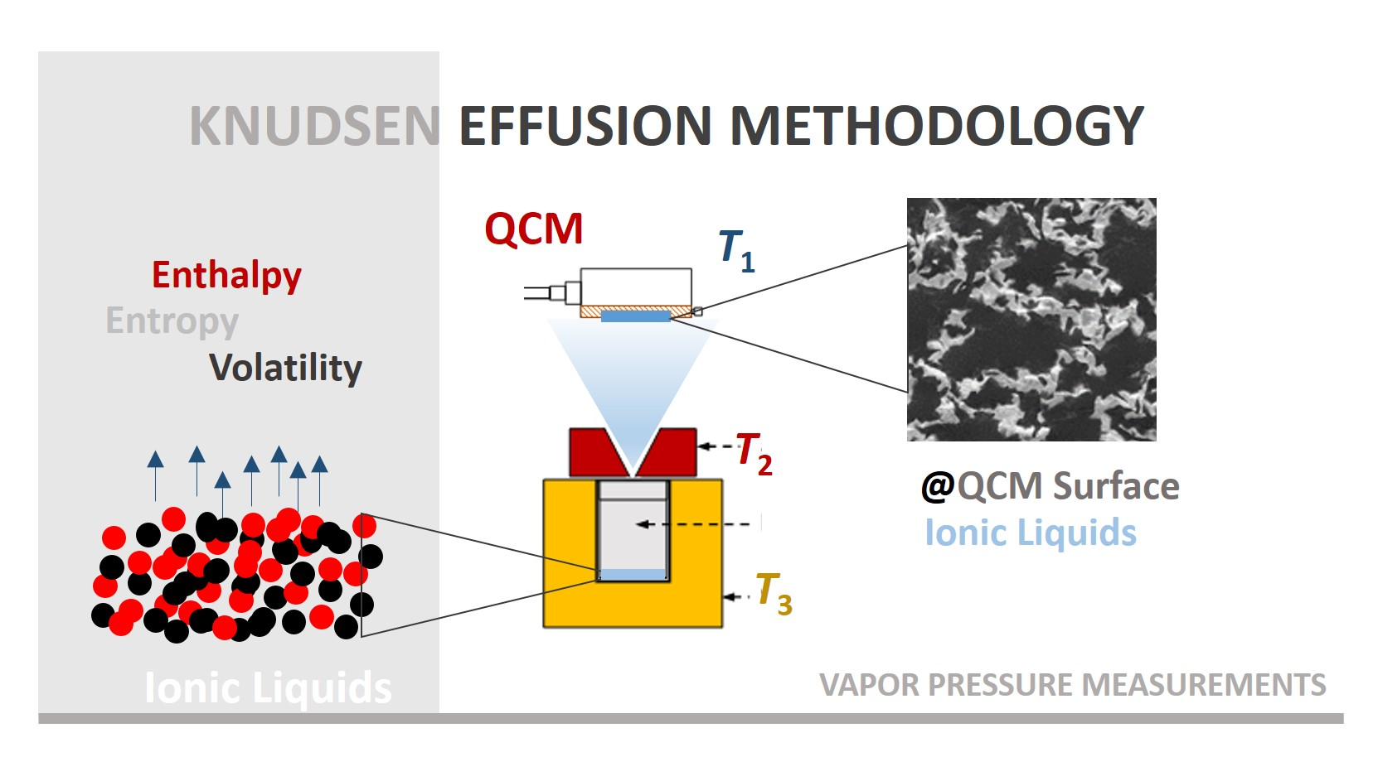
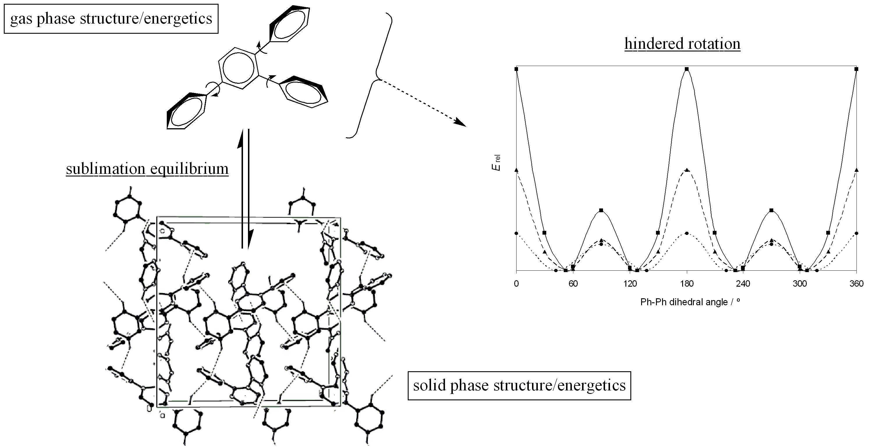
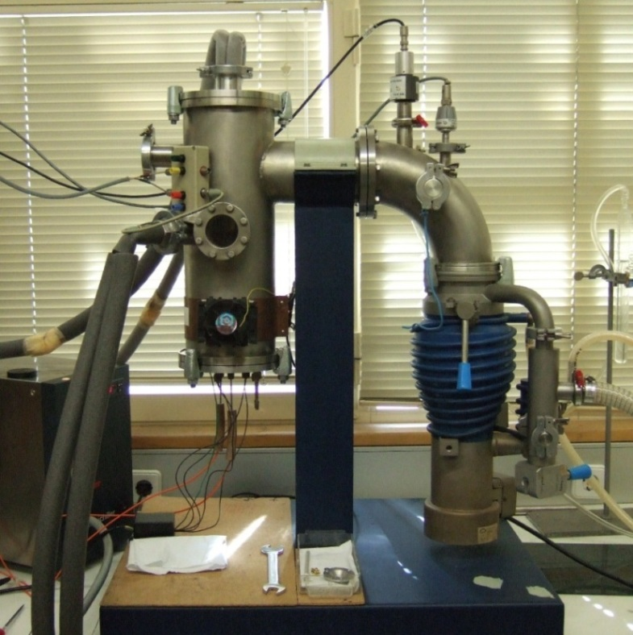
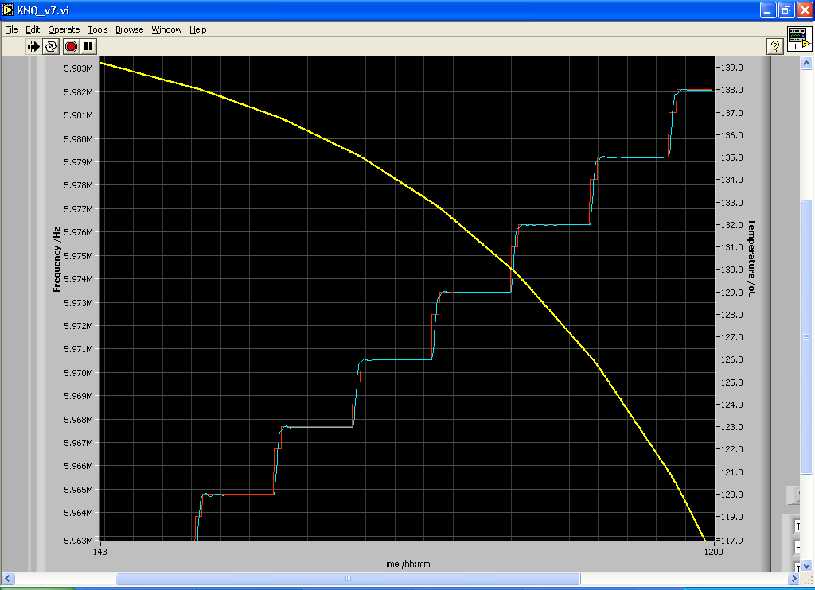
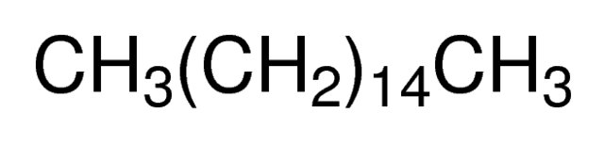



TITLE EXAMPLE POSTER PRESENTATION
Laboratory of Physical Chemistry
Working Group: PL1_A1_T3
Luís Belchior, Pedro Santos
AIM /Scope
Vapor pressure
Volatility
PHYSCHEMLab #0X
Intermolecular interactions
Sublimation/Vaporization
Phase diagrams
Entropy
Cohesive energy
Methodologies & Application
A
B
D
C
Figure 1 –View and Schematic diagram of the Knudsen effusion oven and cell
Figure 2 –Schematic diagram of the Knudsen effusion apparatus
Figure 3 –Experimental methodoly.
Results & Achievements
Binary mixture phase diagram
The solid-liquid phase diagram of methyl stearate and hexadecane have been derived (fig. 4)
Forming a typical eutectic …
eutectic point composition around 0.1 mole fraction of methyl stearate,
Eutectic temperature ~16 ºC.
A small (but detectable in DSC ) solid-solid transition was found at around 4 ºC.
It found that the solid -Solid transition is correlated with the composition of hexadecane.
The region depicted in fig. 4 (gray square) high concentration of hexadecane have to be study more in detail in order to explored the possible formation of co-crystals between the hexadecane and the methyl stearate.
?...
Figure 4 –Solid-Liquid phase diagram.
EXP.01

